Slide 1


MMMMMMMMMM
RV College of
Engineering
Go, change the world
Smart Traffic Signaling Using Computer Vision
For Avoidance of Blind Spots
BY,
KUNAL MAHAJAN (1RV20CS074)
SHREYASA JOSHI (1RV20EC148)

Slide 2

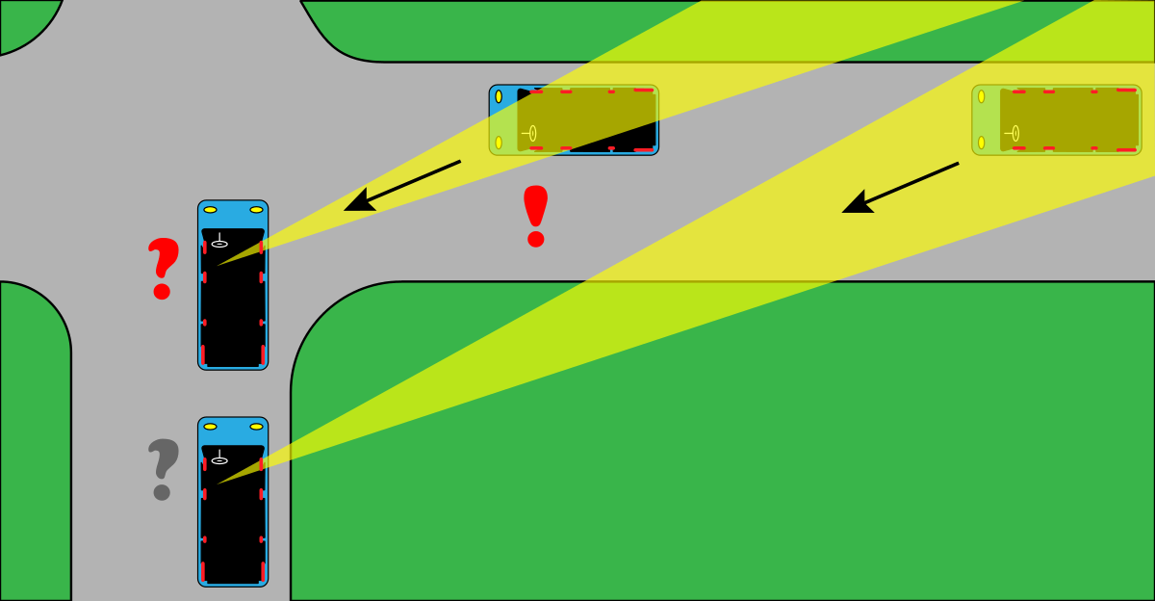
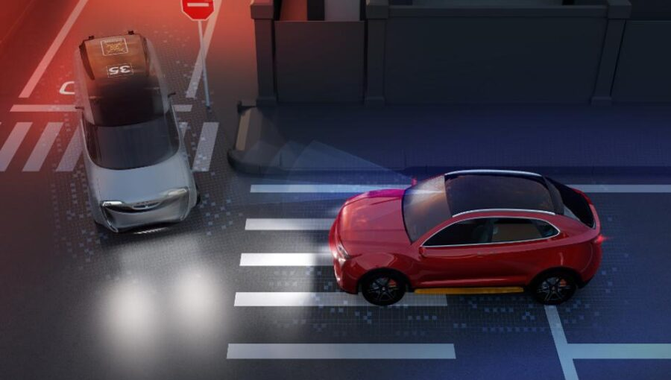
RV College of
Engineering
Go, change the world
BLIND SPOT
Blind Spot Means A Spot That Is Not Covered In Our Field Of View
We are not able to see the vehicles coming from the other turn.
So its like a blind spot to us
By the time we realize that another vehicle is approaching from other end it might be too late to control the vehicles.
We have seen and know many critical accidents caused by this situation.

Slide 3
Go, change the world
RV College of
Engineering
Problem statement
As explained about the blind spot during turn T and L type junctions, recognizing the vehicles approaching and analyzing the real time situation and giving signals at both ends to make the drivers conscious for smooth passing.

Slide 4
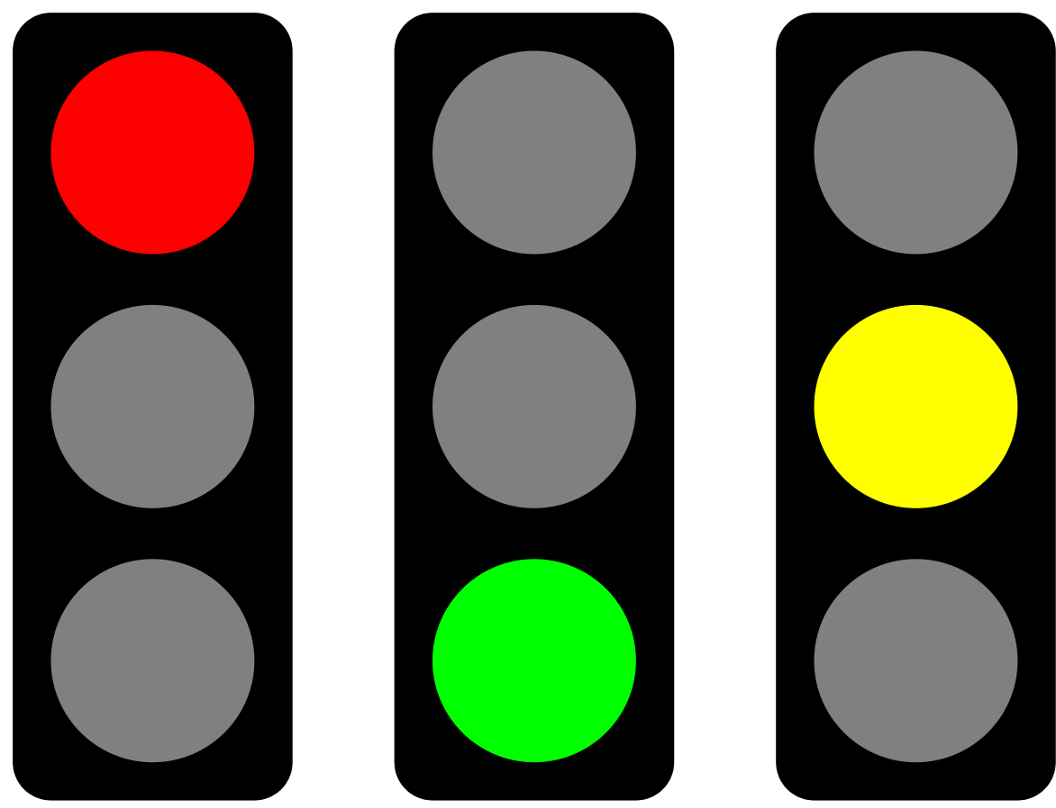
RV College of
Engineering
Go, change the world
Aim
1. First to capture the approaching vehicles using Raspberry-Camera Module and Raspberry Pi Board.
2. Then Analyze the Signal for Both sides and Display Using LED’s the Red and Green Signals Accordingly.

Slide 5
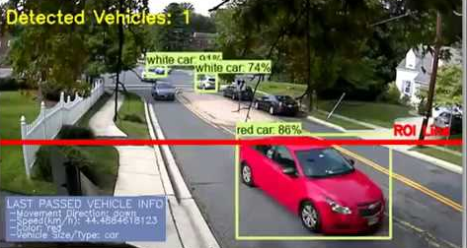
RV College of
Engineering
Go, change the world
Methodology
We are planning to use TensorFlow(Frozen Model) for the database and some OpenCV libraries for recognizing the objects.
Using the previous seconds data we analyze the situation.

Slide 6
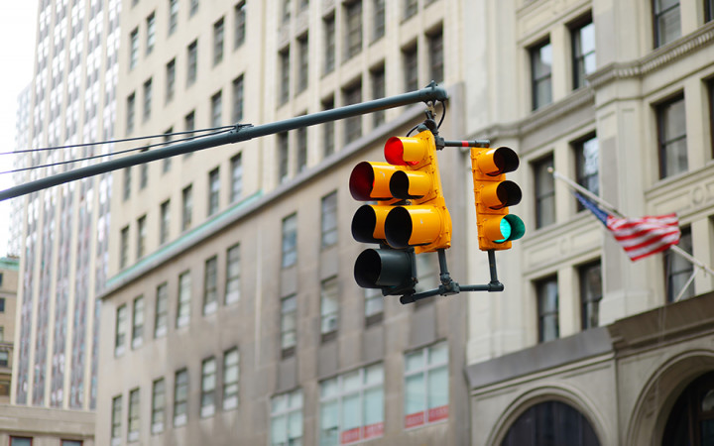
RV College of
Engineering
Go, change the world
We plan to use the area of the vehicles to interpret whether they are approaching or departing from the point.
Using the information we give out the signals to both ways for safe passing.

Slide 7

RV College of
Engineering
Go, change the world
BLOCK DIAGRAM
Raspberry Pi
Input:
Camera 1
Camera 2
Lane 2
S
Processing and Calculations
Output:
Traffic Signals
Lane 1

Slide 8
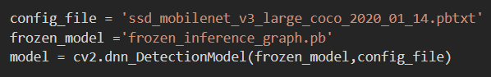
RV College of
Engineering
Go, change the world
Loading Object Detection Model
Here we use a pretrained deep neural network(DNN) model to detect and identify the Objects in the frames provided by the cameras.
So we use a frozen model coded in TensorFlow backend
(Frozen model means a singular file containing information about the graph and checkpoint variables, and having the hyperparameters as constants within the graph structure)
pb stands for protobuf. In TensorFlow, the protbuf file contains the graph definition as well as the weights of the model. Thus, a pb file is all we need to be able to run a trained model

Slide 9
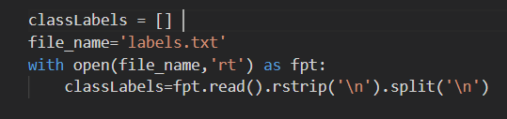
RV College of
Engineering
Go, change the world
Model Objects
The model we imported for detection consists of classified 80 objects.
Of which we are interested in only 4 objects (Car, Bikes, Trucks and Buses)
So we store this 80 classes labels as a list to refer to a particular object.
So we open the text file with the names of objects and then make a list out of it using read, rstrip and split functions.
Read function reads the contents of the file
Rstrip function separates each string in the text file into a new line
Split function makes each line string as a list element

Slide 10

RV College of
Engineering
Go, change the world
Detection Model Parameters
INPUTS:
Frame: The image to be studied
confThreshold: The minimal confidence with which the labels are to be assigned to the image.(we use a confidence percent of 55)
OUTPUTS:
ClassIndex: The class to which the particular object belongs is stored as list in this according to increasing areas the objects occupy.
Confidences : The probability of the recognized object to actually be what it is detected.
Boxes : The set of vertices of the Objects detected block(Which we use to calculate Area)

Slide 11
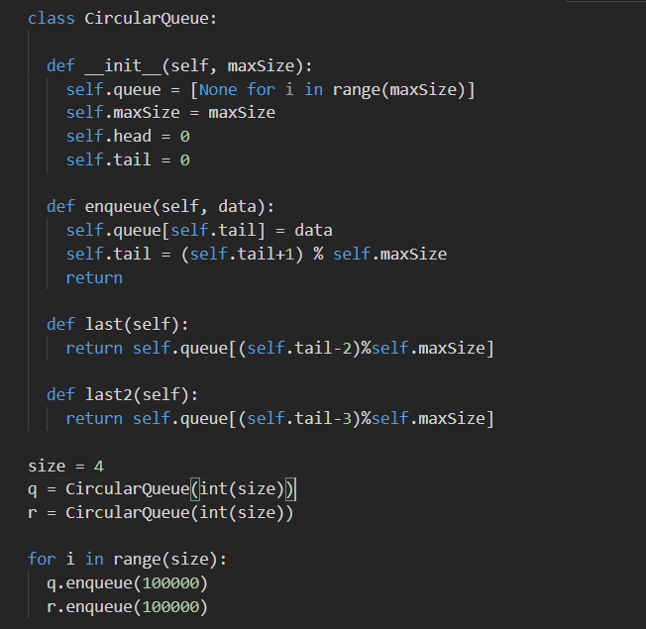
RV College of
Engineering
Go, change the world
DATA STORAGE
We place 2 cameras in the two direction of analysis When 1 camera is capturing a frame The other cameras frame is studied and the situation of objects is recorded then toggled after every 0.1 second.
So to study weather a particular vehicle is approaching or departing we use the area it occupies in the frame and compare with the previous areas.
As we know from a particular point of view the area of objects keeps increasing if it is approaching towards the source and keeps decreasing if its departing.
So for this we maintain 2 circular queues for size 4 for storing the previous 3 frames areas for comparison.
And keep overwriting on the last 4th frame.

Slide 12
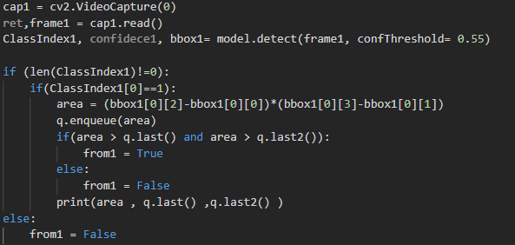
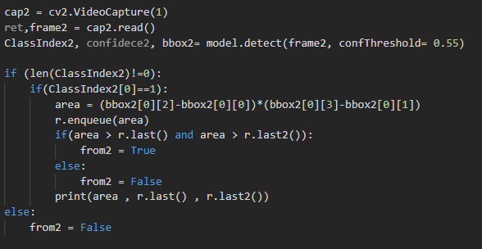

RV College of
Engineering
Go, change the world
Working
DIRECTION 1
DIRECTION 2
First the frame is read from the camera and then given as input to our model for classification and analysis
Then the model Analysis the frame and gives us the parameters.
Using the parameters we differentiate our required objects and calculate the area of the nearest vehicle and store it into Queues.
Then we compare the current value of area with the area of the previous 2 frames to check its motion
Then if its approaching we change the flags to true

Slide 13
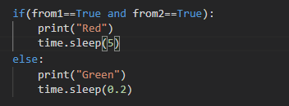
RV College of
Engineering
Go, change the world
Decision Making
If Both the flags are set as True then its implies that we have a approaching vehicle from both the lanes so we set the signal to red.

Slide 14
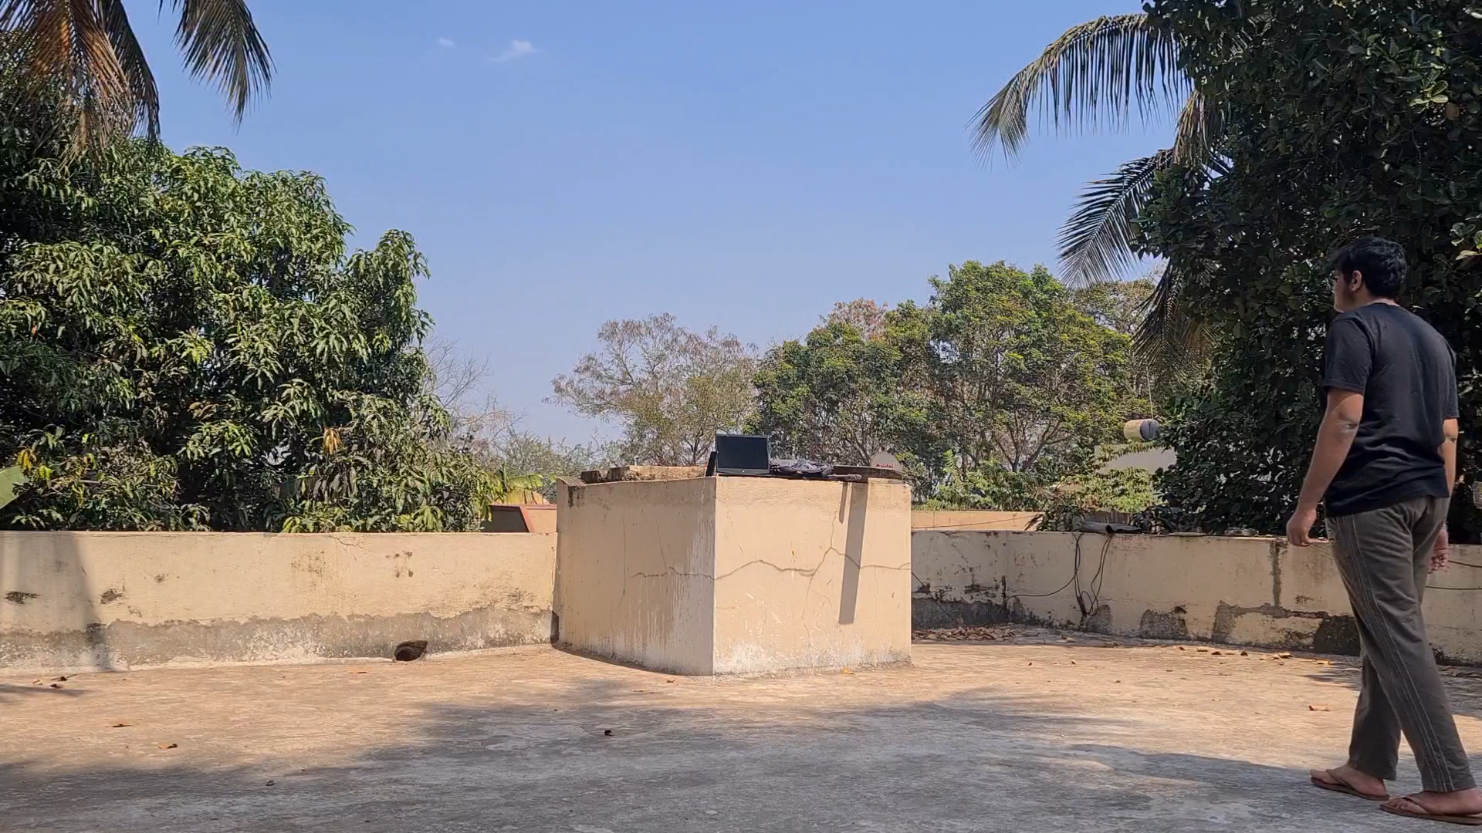
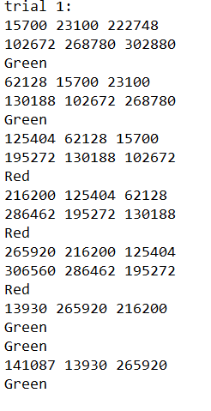
RV College of
Engineering
Go, change the world
Case 1

Slide 15
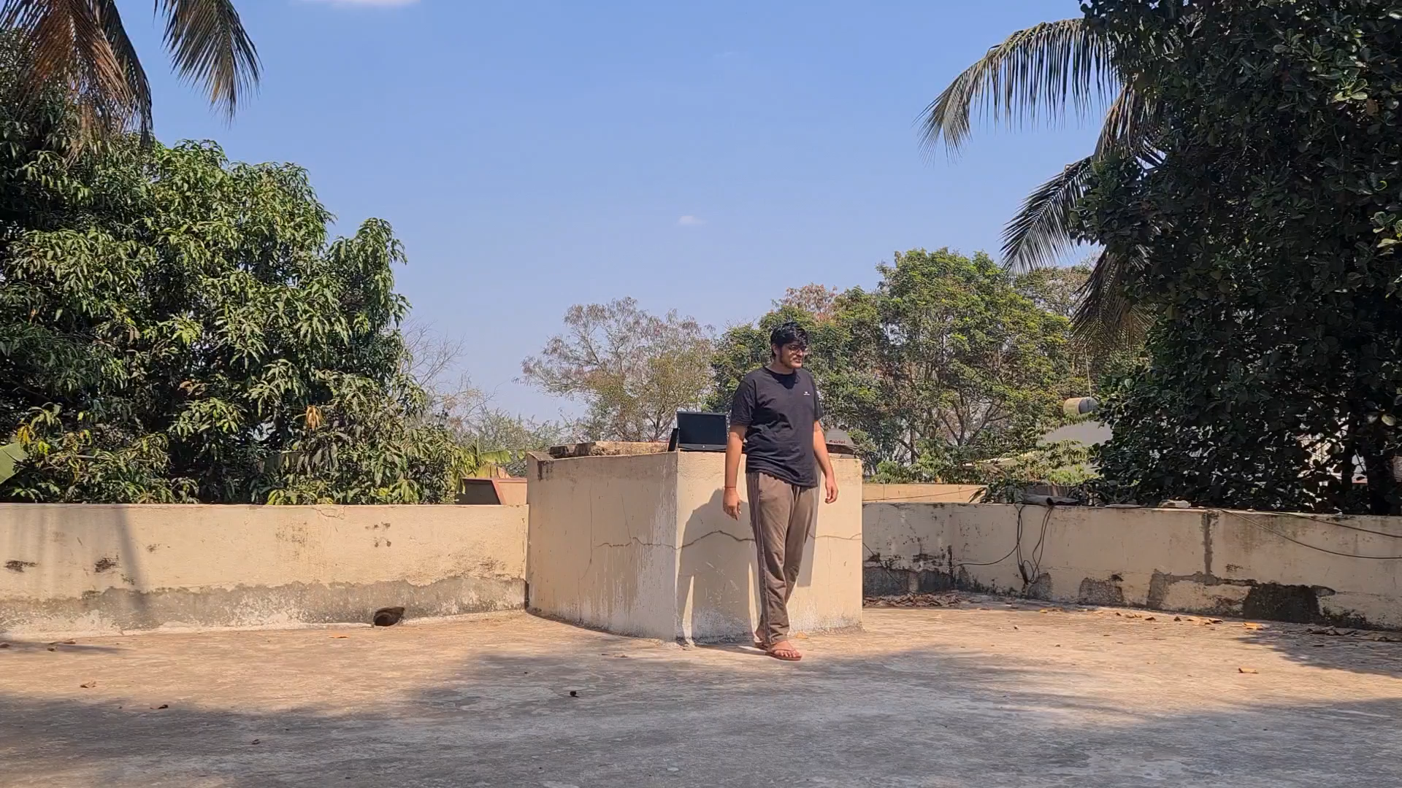
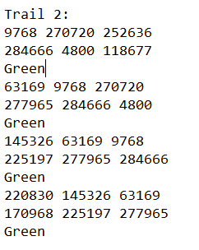
RV College of
Engineering
Go, change the world
Case 2

Slide 16
RV College of
Engineering
Go, change the world

Slide 17
RV College of
Engineering
Go, change the world

Slide 18
RV College of
Engineering
Go, change the world

Slide 19
RV College of
Engineering
Go, change the world

Slide 20
RV College of
Engineering
Go, change the world

Slide 21
RV College of
Engineering
Go, change the world

